Slide 1
Session 2: Follow up (to kick-off)
Creative problem solving in teams using Design Thinking (DT) A practical guide
EMPATHISE
IDEATE
DEFINE
PROTOTYPE
TEST
A course by Kirsten Nazarkiewicz (Prof. Dr.), Adelheid Iken (Prof. Dr.), supported by Erik Schumb (agile sprints)

Slide 2
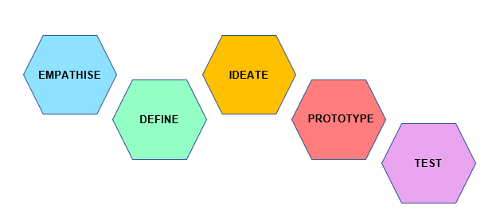
Agenda Kick off – follow up
Welcome & Agenda
Meeting of teams
Q & A regarding material and task
How to pitch
Typical team situations: team work and discussion
Discussion of group results
Conflict prevention: conflict models and tools that are “door openers”

Slide 3
Your questions: please exchange your reading experiences and collect questions
Q & A

Slide 4
Presentation guidelines – How to pitch I
Time: 25 minutes per Team
15 Minutes Introduction of Team and Pitch
10 minutes discussions and questions (make sure you keep the time frame!)
Presentation (15’)
1. Introduce: your challenge and project briefly
2. Pitch: 10 Minutes max.
Share: Show us (and potential stakeholders) your result(s).
“Sell”: Develop convincing arguments of the project to gain approval.
Illustrate: Use a creative format
Discussion (10’)
Q + A
Evaluation / Reflect: what you would consider to be the next step, if you want the project to be realised.

Slide 5
Design Thinking – How to pitch II
Pitch
The work with the tools on your challenge will lead to a “pitch”. A pitch is a short presentation with the goal of convincing an audience regarding an idea (your prototype) and to sell it. A pitch can last from 30 seconds to 45 minutes. Your facilitators will give you a time frame.
A pitch follows a story line and aims at catching the attention of the audience right from the beginning. Problems are made emotionally comprehensible and the product you developed leads to a resolution of the tension. You will find more information in the tools ‘storytelling’ and ‘storyboarding’.
You can find an explanation of how to start a pitch in the following two clips:
How to pitch in 3 Minutes. https://www.youtube.com/watch?v=XWRtG_PDRik
Some hints regarding the start of a pitch: https://www.youtube.com/watch?v=P2LwuF7zn9c
You are free to choose a format. It should be informative and creative, stakeholder oriented using a Storytelling style. You may produce a video clip, a cartoon or pictogram serie, a powerpoint or prezi presentation, an account on instagram or other webbased tools. You may record it in advance or preferably present it live in online meetings. Make sure to convince and “catch” your audience. Here are some inspirations:
Video pitch for a chocolate bar in 3 Minutes: https://www.youtube.com/watch?v=bNhF4JKGk7A
Example for a pitch with PowerPoint in 8 minutes (starts at 1’38): https://www.youtube.com/watch?v=7a_lu7ilpnI
Note: These are just best practices and recommendations. You are free to choose your own creative way of convincing your audience.

Slide 6
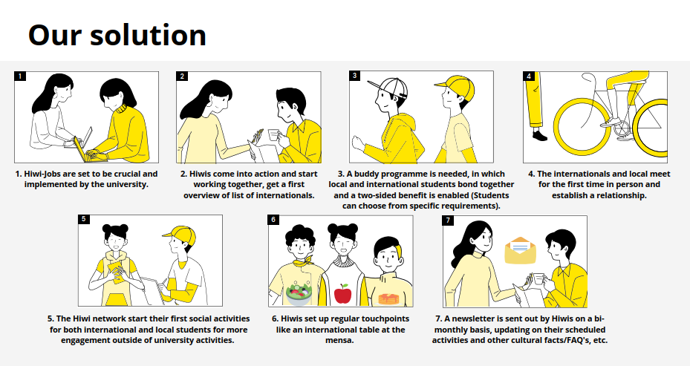
Examples for pitches from previous groups
Other examples: Prezi: https://prezi.com/p/dalfor6ashdh/?present=1 Instagram: Universi.ties Instagram: imbo_hh_fd,

Slide 7
Your questions
Q & A

Slide 8
Possible cases
Picture this
One of your team members does not show up in the first two meetings and is late for the 3rd one.
What do you do?

Slide 9
Characteristics of conflicts
What are conflicts for you?
Collect on INSERT TOOL
3 min.
9

Slide 10
Characteristics of conflicts
Conflicts are emotionally charged
Pressure to resolve
Tendency to escalate
"stepping on the court”
Relationship-threatening
Definition: A conflict is...
an interaction
between 2 or more persons/parties
in which an incompatibility is experienced by at least one side
(Friedrich Glasl)
10

Slide 11
Task regarding typical Situations and how to deal with them
On the following slide there is a list of typical situations in virtual heterogeneous teams.
Task
Firstly, exchange your (maybe different) personal reactions to the situation.
Collect different strategies / solutions / ways to handle the situation (you don´t have to find a consensus or compromise!
Create a slide with your results: Cut and paste your task and your answers to your task regarding 1 and 2 on the empty slide (we provided one on moodle, Fulda students can download the slide)
Select someone to represent the team and present (3 Minutes)
You will meet in your teams and work on the task of your team number! Time box: 20 Minutes
Please ignore the other tasks for a moment.

Slide 12
Typical situations – and how to deal with them
You strongly disagree with an idea of a revised challenge; time is running and your team members are already getting nervous. How could you possibly make your point?
What would be some of the things you would like to clarify and get a common understanding of before you start working together? Also think about what may send you up the roof or really drive you bananas.
You know that for agreeing on the amended challenge, it is not enough to compromise but it would be beneficial to reach a consensus. What is the difference between consensus and compromise and what are the required communication processes related to these. What could be some of the stumbling blocks towards this end and how could you possibly deal with them?
What would be a situation you would take feedback of a team member into consideration? Giving and receiving feedback is a central but sometimes also tricky task. Please think about central rules you, as a team, would consider to be important for working well together. Give examples how you would apply the rules.
Very often teams feel that the work is not equally divided and they experience people one may call free-riders, people who are not getting engaged but nonetheless expect to benefit from the work of others. How could you possibly ensure that people share the work and what could you do in case a feeling comes up, that you may have a free-rider in the group.
One of your team members has greatly underestimated the time needed for you common project and is completely stressed out. How could you possibly deal with this situation?
After the preparations for the pitch had been completed, a team member thought that they should shoot another film, for which there was no more planning time. The team member then did everything on his or her own and insists on showing the clip as the pitch. How could you possibly deal with this situation?
In the session where you are supposed to present you pitch one of the team members does not show up. How would you deal with the situation and what would you do afterwards?
The students of the other university are much more driven / direct / faster / dominant than what you are used to practice in your study group.

Slide 13
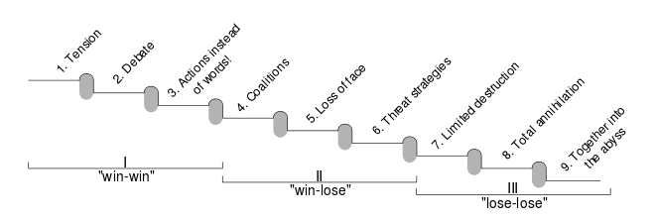
Conflict models and phases: Conflicts in Teams by Glasl
Always try to go on step backwards !

Slide 14
Conflict strategies (TKI model)
Orientation to own needs
enforce
cooperation
enforce
compromise
avoid
adjust
cooperation
Orientation to the needs of others
14
Notes:
Thomas kilman Model (TKI)

Slide 15
Conflict models and phases: tools
How to prevent potential conflicts
Agree on a communication culture – especially for “bad times”
Spot tensions, articulate discomfort as early as possible
Follow the “Disturbance Postulate”: “Disturbances and passionate involvements take precedence” (Ruth Cohn, TCI)
Try to have the focus on the common problem not on the conflict ( = the others are the “problem”)
Use “door openers” (Gordon): verbally conveyed acceptance (“e.g. I'm interested in how you see things”)
Use I messages and self-relevation: e.g. “I feel unfcmfortable speaking in German all the time”
Use mirror statements: e.g. “May I summarize what I understood?”
Practice meta communication: e.g.: “let´s take the time to understand each other´s positive intentions”

Slide 16
Good luck!
All the best for your teams and Design Thinking challenges!

